Slide 1

ICE 3161
COMMUNICATION ENGINEERING
Dr. Asif Zaman
Professor, CSE, RU

Slide 2
Data and Signals
• What is Data???
• Data is a collection of discrete or continuous values that
convey information,
describing the quantity, quality, fact, statistics,
other basic units of meaning,
or simply sequences of symbols that may be further interpreted formally.
To be transmitted, data must be transformed to electromagnetic signals.

Slide 3


Analog and Digital Data
Data can be analog or digital.
The term analog data refers to information that is continuous
digital data refers to information that has discrete states.
Data
Analog
Digital

Slide 4
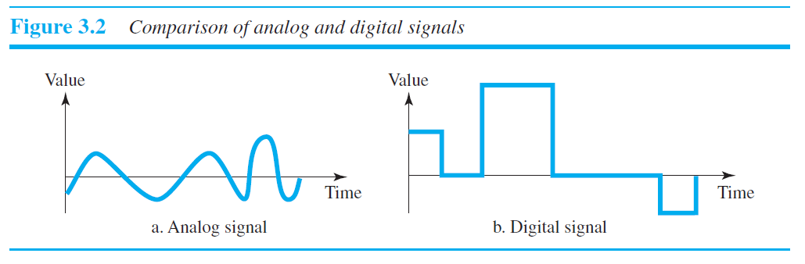
Analog and Digital Signals
Intensity: strength/power
Signal
Analog
Digital
Signal refers to any time-varying voltage, current, or electromagnetic wave that carries information.
Signals can be either analog or digital.
An analog signal has infinitely many levels of intensity over a period of time.
A digital signal, on the other hand, can have only a limited number of defined values.

Slide 5
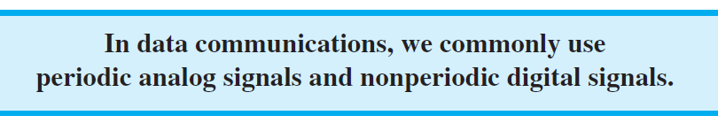
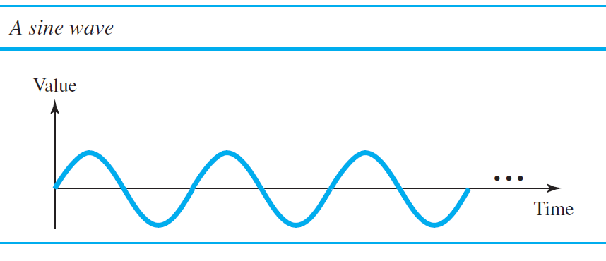
Periodic and Nonperiodic
Both analog and digital signals can take one of two forms:
periodic or
nonperiodic
A periodic signal completes a pattern … time frame, (period), and repeats that pattern over subsequent identical periods.
The completion of one full pattern is called a cycle.
A nonperiodic signal changes without exhibiting a pattern or cycle that repeats over time.
Signal
Analog
Digital
Periodic
NonPeriodic
Periodic
NonPeriodic

Slide 6
Periodic Analog Signals
Signal
Analog
Digital
Periodic
NonPeridic
Periodic
NonPeridic
Simple (sine wave)
Composit
Periodic analog signals can be classified as: - Simple & - Composite
A simple periodic analog signal, a sine wave, cannot be decomposed into simpler signals.
A composite periodic analog signal is composed of multiple sine waves.

Slide 7
Sine Wave
A sine wave is a geometric waveform that oscillates (moves up, down, or side-to-side) periodically, and is defined by the function y = sin x.
In other words, it is an s-shaped, smooth wave that oscillates above and below zero.
A sine wave can be represented by three parameters:
peak amplitude
frequency
phase
These three parameters fully describe a sine wave.

Slide 8
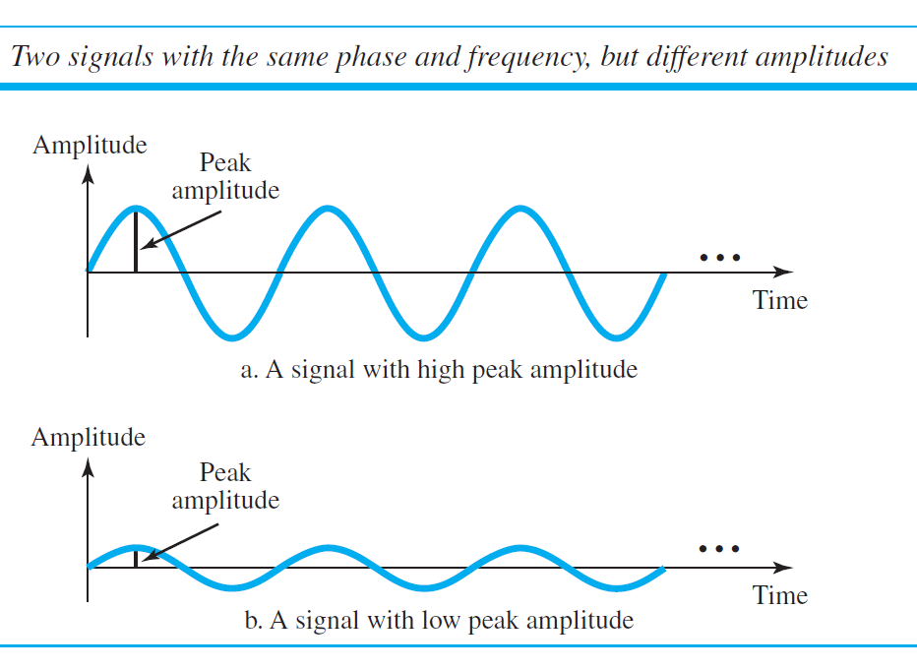
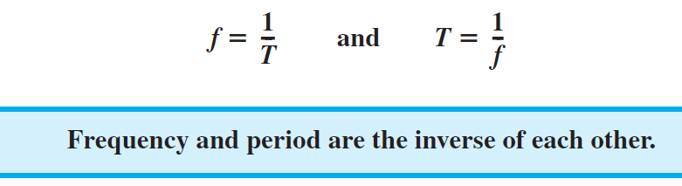
Period
refers to the amount of time, in seconds, a signal needs to complete 1 cycle.
Frequency
refers to the number of periods in 1 s.
Period is formally expressed in
seconds. Frequency is formally expressed in Hertz (Hz), which is cycle per second
Peak Amplitude
The peak amplitude of a signal is the absolute value of its highest intensity, proportional
to the energy it carries. For electric signals, peak amplitude is normally measured
in volts.

Slide 9
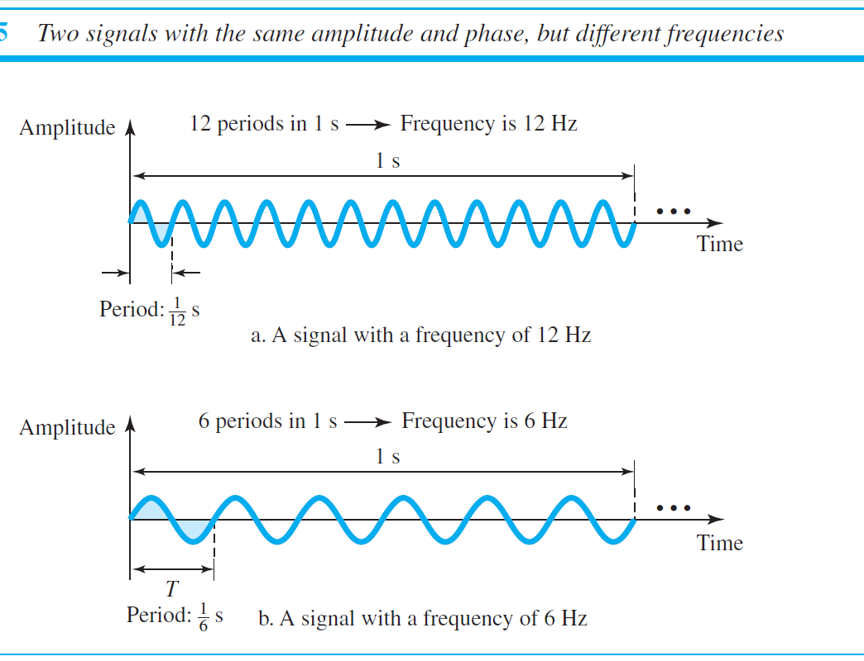
Q: Give us an pictorial example of two signals with same amplitude and phase but different frequencies???

Slide 10
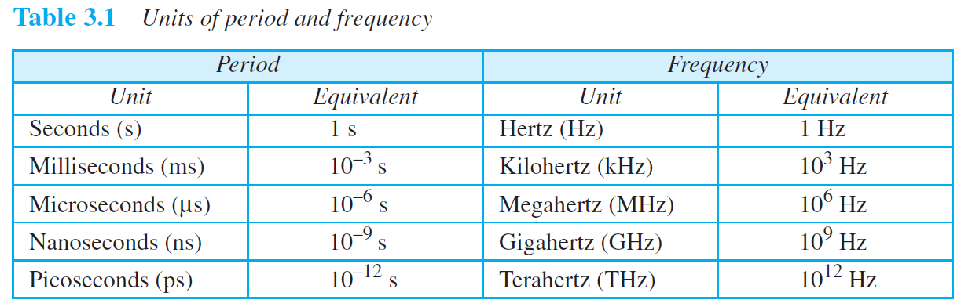
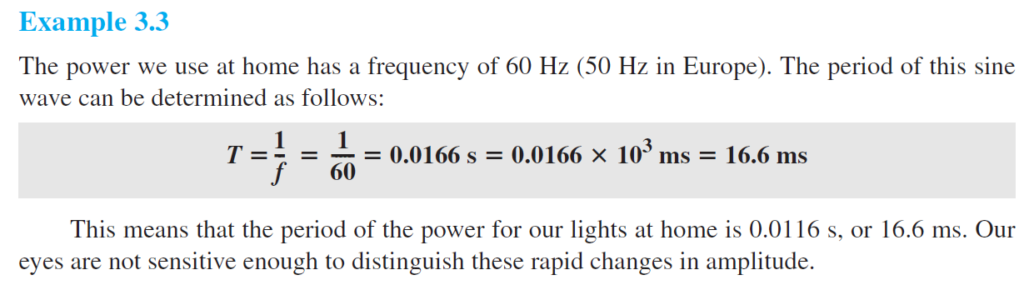
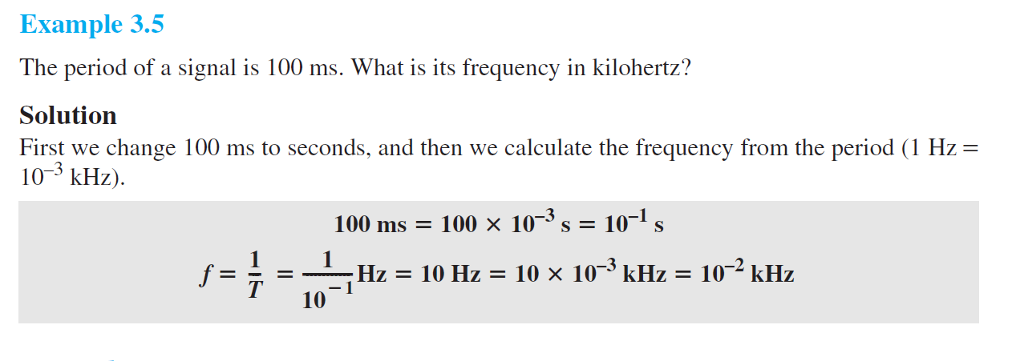

Slide 11

Phase
Phase is measured in degrees or radians.
360° ̶» 2π rad
1° ̶» 2π/360 rad
1 rad ̶» 360/(2π) °
A phase shift 360 ° … shift of complete period
A phase shift 180 ° … shift of one-half (½) of a period
A phase shift 90 ° … shift of one quarter (¼) of a period

Slide 12
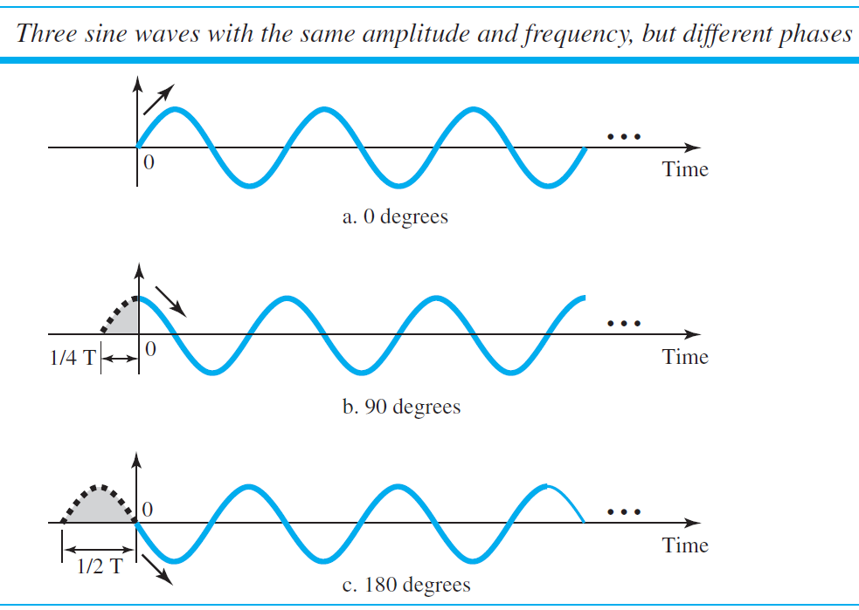
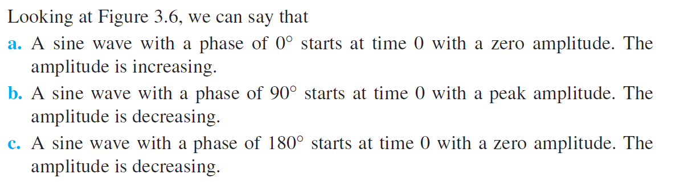
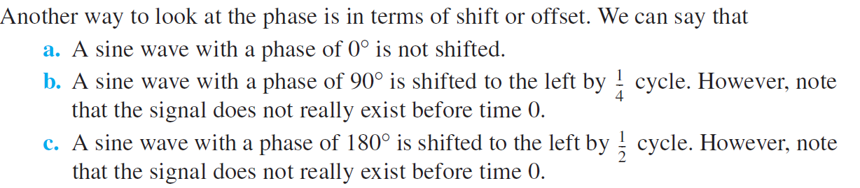

Slide 15
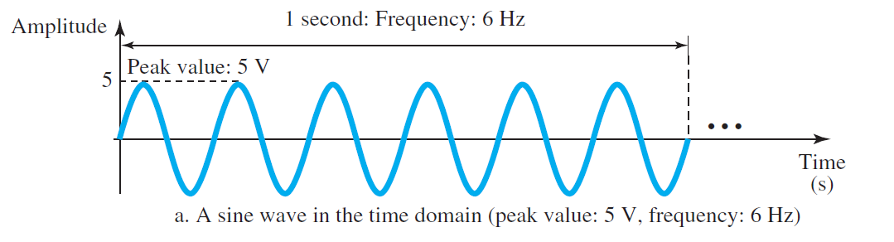
Time and Frequency Domains
A sine wave is comprehensively defined by its amplitude, frequency, and phase.
We have been showing a sine wave by using what is called a time-domain plot.
To show the relationship between amplitude and frequency, we can use what is called a frequency-domain plot.

Slide 16
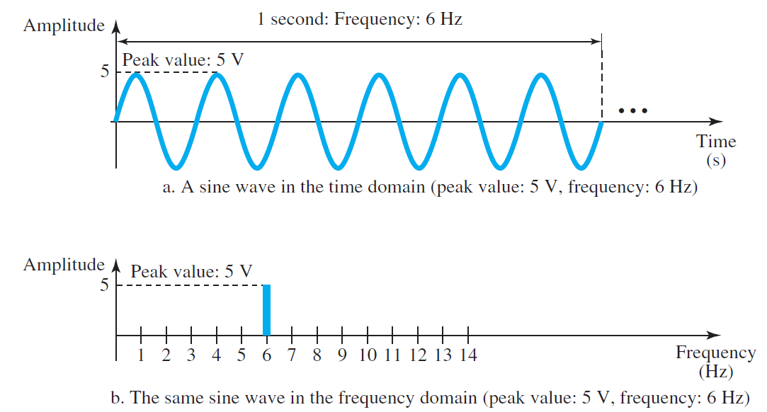

Time and Frequency Domains

Slide 17
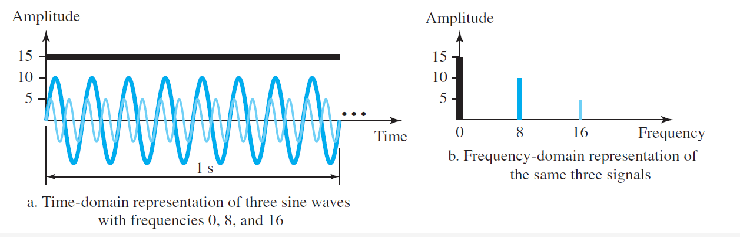
Time and Frequency Domains
The frequency domain is more compact and useful when we are dealing with more than one sine wave.

